Slide 1

Web Portal for Sampath Bank
ITP-2018-MLB-G3-10
IT17395588 – Samarasekara S.A.M.I.D.
IT17139786 – Bogahawatte W.W.M.K.A.
IT17137492 – Atheeq M.M.M.
IT17138796 – Sandeepani K.K.T.
IT17134668– Gamage V.S.
IT17156998 – Wijemanna M.D.C.V.
IT17134736 – Subasinghe S.M.M.K.
IT17138864 – Sankalpani K.K.T.

Slide 2

Introduction
Company Profile
Sampath Bank PLC is a locally renowned leader in private banking sector.
It is a leading bank in a technological standpoint.
First Bank to introduce ATMs and Master Card to Sri Lanka and Debit Card to South Asia
First Bank to operate with fully computerized database and technologies.
Problems
Actual Problems
Simulated Problems
Inability to calculate monthly lease rental for users
Currently – Excel Work Sheet (Macros)
Technical Difficulties
Inability to attract customers due to less attractive Web Portal.
Current web portal inconvenient to use.
Inability to login to the local server
Difficulty is exporting excel sheets
Inability to generate and store security documents

Slide 3
Solution for Actual Problem
Solution for Simulated Problems
Develop a user-friendly web portal for the client which; manages users of all kinds, enables online transactions for customers whilst managing them, facilitates employee and payroll management, handles inventory as well as procurement, oversees fault and complaints, conducts Loan/Deposit/FD calculations and handling, finally, which holds the earlier mentioned leasing implementation.
Design and implement a Leasing Calculator, along with the facility to print needed security documents, which is expected to overcome all technical difficulties mentioned above and enable the branches to facilitate smooth operation process for Leasing facilities.

Slide 4
Overall Benefits
Prepare the detailed salary record of all the employees and generate the pay-in-slip through the calculation of the salary.
User management aims to grant authorized users the right to use the system conveniently while preventing access to un-authorized users.
Professionally manages the user accounts by notifying users about the changes made in their accounts.
Efficiently manage the company’s inward and outward items.
Make sure the company has the sufficient stock levels to meet the requirements.
Develop strong relationships with other groups within the bank.
Manage the procurement processes and the supply base efficiently.
Capture, gather, process and store transactions and to produce useful documents related to routine bank activities.
Ensure data and information integrity and maintain a high degree of accuracy.
Promptly identifies loans/FD with well-defined weaknesses.
Provides management and directors with an objective assessment of portfolio quality.
The leasing calculator will display the monthly rental for the leasing facility (including structured lease) and Lease Capital, once the required data is entered.
Generate and provide the customer with the necessary documents as evidence for transactions that took place within the bank.
Improve confidence in the performance by implementing functions to guarantee the company’s integrity is not compromised.
Make sure the system is protected against high-risk faults, which will play a major role in limiting risk due to potential for undesired Fault Management behavior.

Slide 5
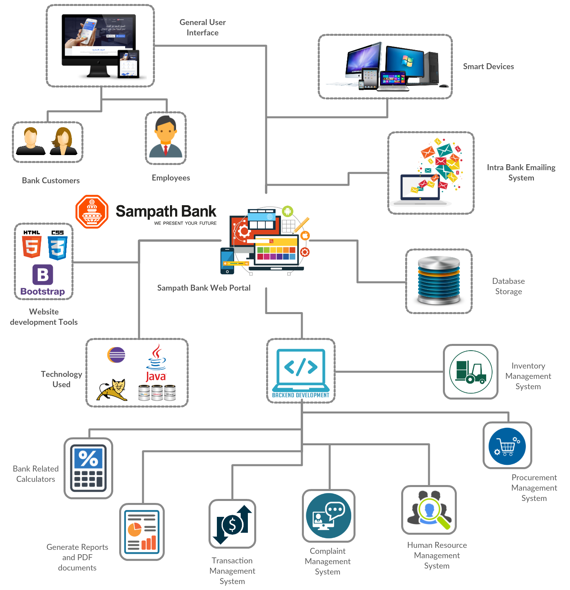

System Overview

Slide 6







Employee Management System
Recruitment of Employees
Documenting Employee in specific department
Updating Employee Records
Evaluating Employees Performance
Searching Employee Records
Leave request management
Calculating Salary

Slide 7




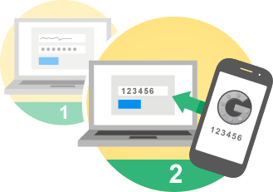


User Management System
Account Creation
Redirecting Webpage
Initial Password Setting
Changing Personal Details
2-way Login Validation
Generating Reports
Intra-Company Mailing System

Slide 8






Inventory Management System
Warehouse – Branch
Tracking
Branch Head Requesting Item
Re-Stock Alert
Searching inventory items
Generating Reports regarding inventory
Recording inward and outward inventory

Slide 9






Procurement Management System
Finding Suppliers
Finding Low cost Providers
Preparation of order invoice
Manager should be able to confirm orders
Updating Supplier Details
Generating Procurement process report

Slide 10






Transaction Management System
Checking outstanding balance
Standing orders should be decremented
Viewing Transaction History
Generating required Documents
Inter and Intra bank transactions
Receiving Notification for each transaction

Slide 11






Loan/Deposit/FD/Gift Management System
Displaying Interest rates specific to loan
Modify Interest rates - Manager
Generate Reports and loan documents
Gift Calculator
Suggesting best loan options for logged in customers
Loan Calculator – to get monthly installment amount

Slide 12



Lease Calculator and Security Documents
Storing Lease related Documents
Generated Lease related Documents
Lease Calculator

Slide 13





Fault/Complaint Management System
Complaint Lodging
Complaint Handling
Tracking Complaint History
Chatting Interface
Employee - Customer
Card Cancellation

Slide 14
Gantt Chart

Slide 15


